Slide 1
Лекция 5. Списки
ListVew, RecyclerView

Slide 2
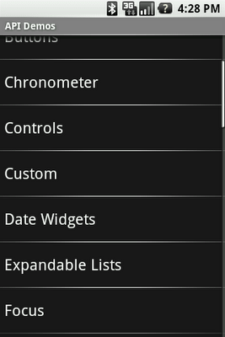
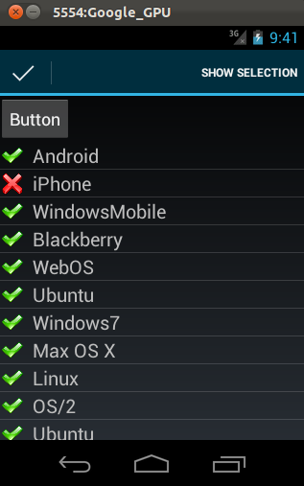
ListView

Slide 3
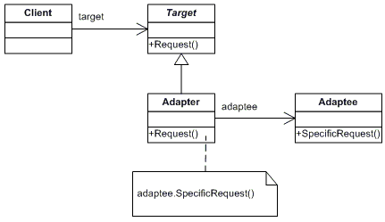
Паттерн Adapter

Slide 4
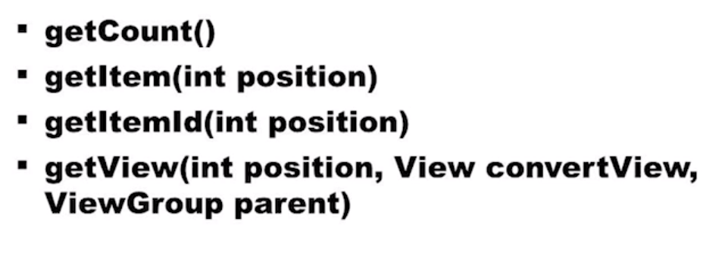
Адаптер
Childs
Position
Id
ВaseAdapter

Slide 5
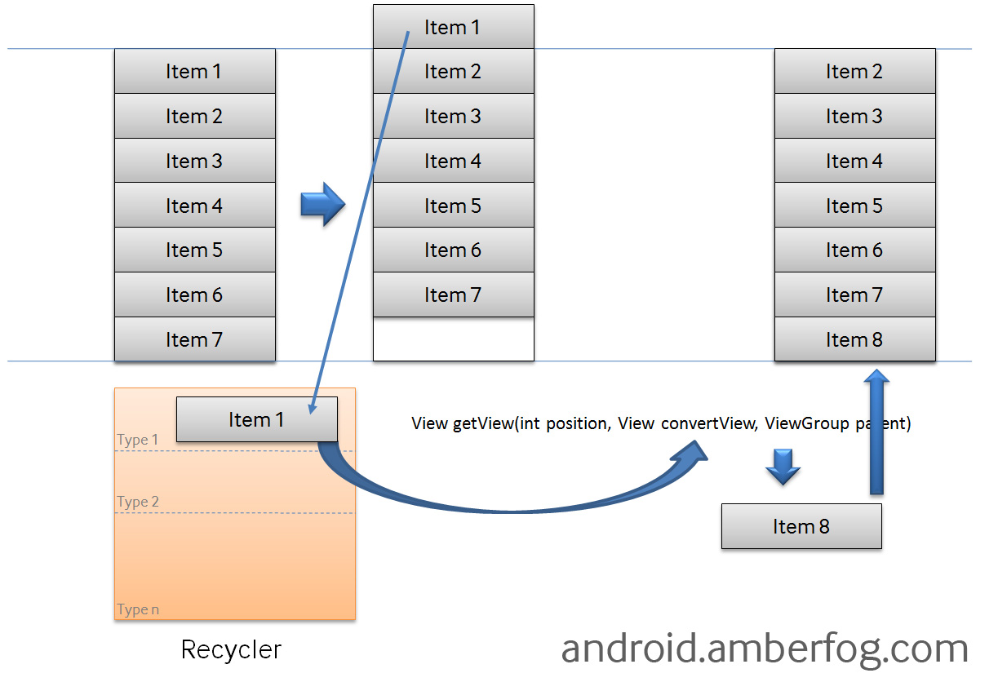
Recycle Bin

Slide 6
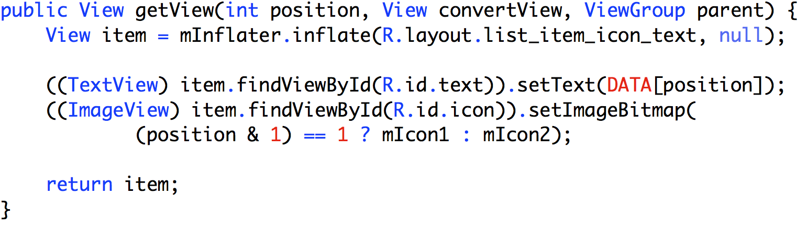
Совсем плохо

Slide 7
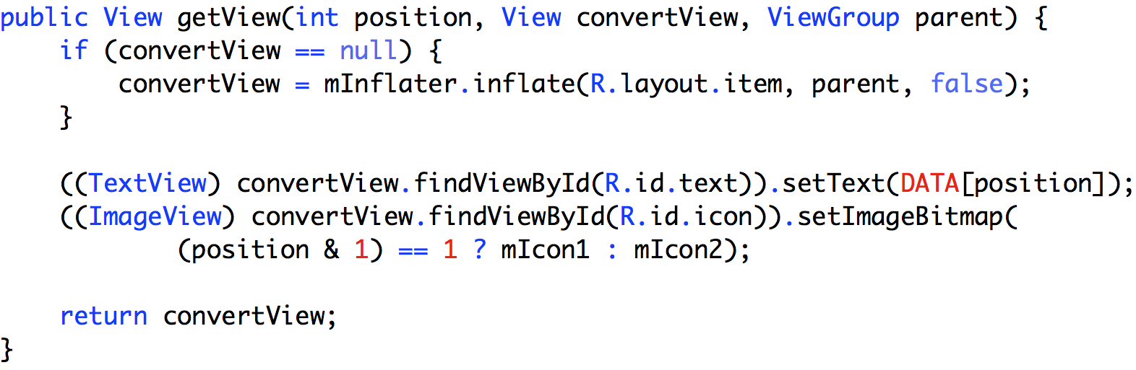
Оптимизация

Slide 8
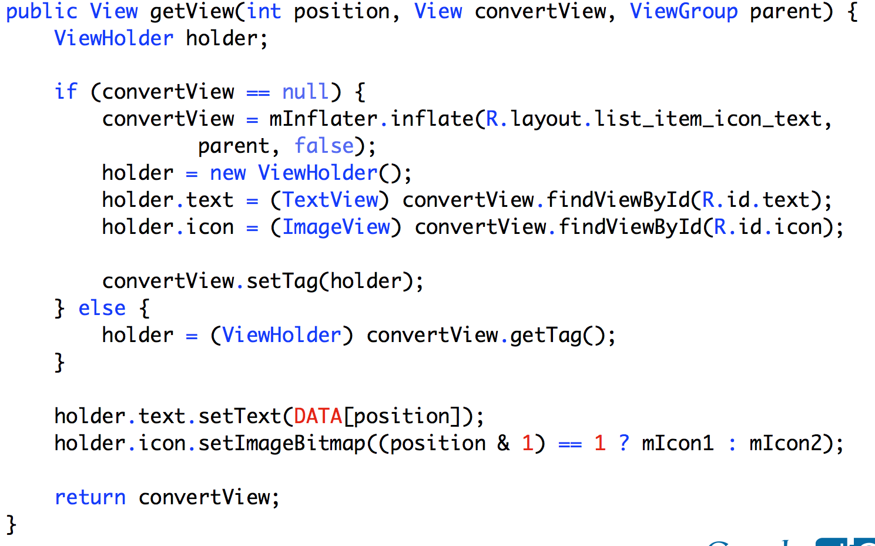
Совсем хорошо

Slide 9
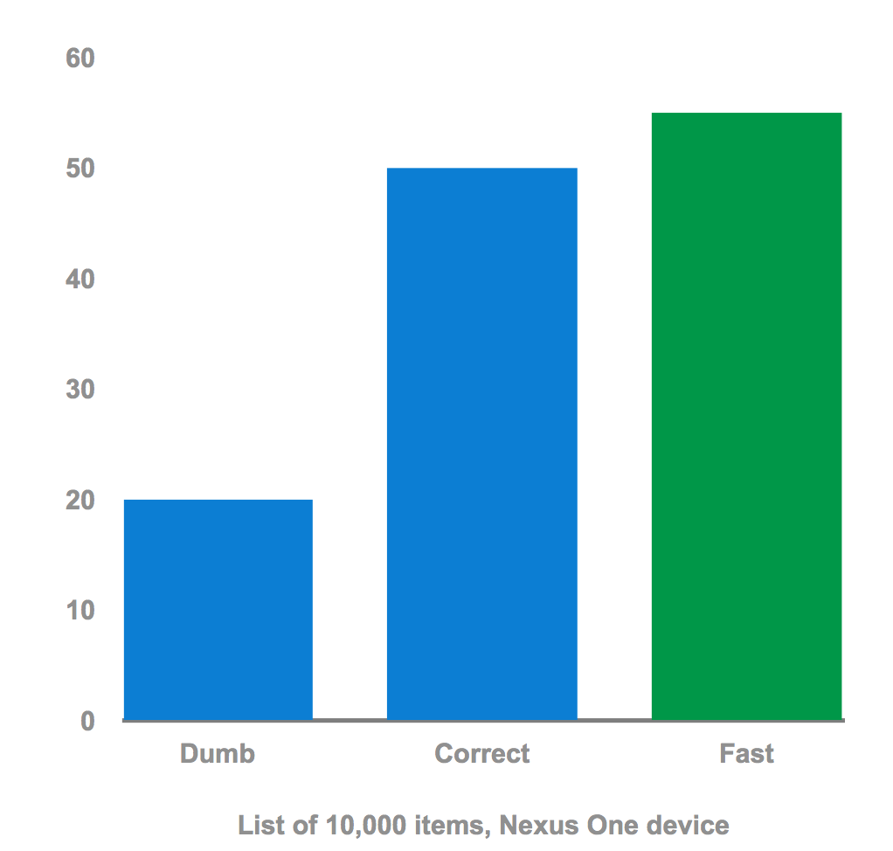
Benchmark

Slide 10
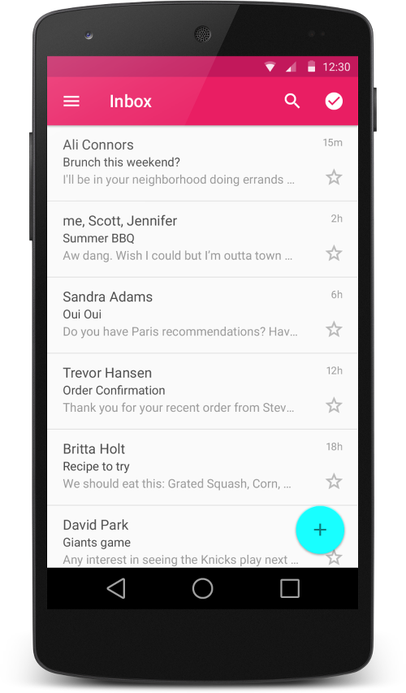
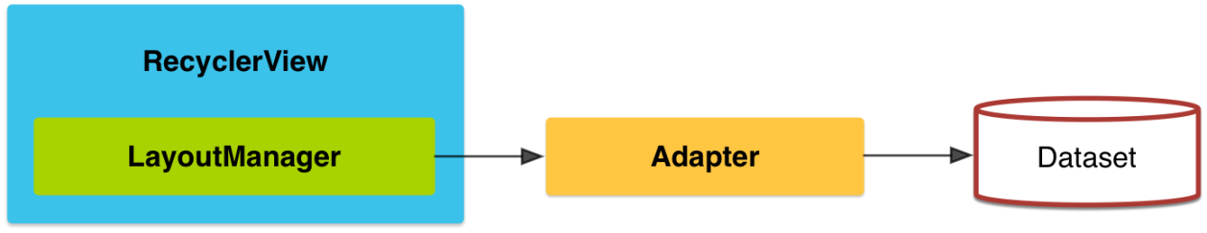
RecyclerView
Как и ListView работает с Адаптером
В основе обычно CardView

Slide 11
RecyclerView
ListView с обязательным ViewHolder-ом
static class ViewHolder extends RecyclerView.ViewHolder{ TextView text; ImageView image; public ViewHolder(View itemView) { super(itemView); text = itemView.findViewById(R.id.itemText); image = itemView.findViewById(R.id.itemImage); } }

Slide 12
CardView
Подкласс FrameLayout class
CardView может иметь тени и закругленные углы.

Slide 13
Зависимости
Необходимые зависимости
Compile 'com.android.support:recyclerview-v7:25.+'
compile 'com.android.support:cardview-v7:25.+’

Slide 14
RecyclerView
В разметке
<android.support.v7.widget.RecyclerView
android:id="@+id/list"
android:layout_width="match_parent"
android:layout_height="match_parent"/>
В коде
mRecyclerView = (RecyclerView)findViewById(R.id.list);
mRecyclerView.setLayoutManager(new LinearLayoutManager(this));
mRecyclerView.setItemAnimator(new DefaultItemAnimator());
mAdapter = new myAdapter(values, R.layout.my_row, this);
mRecyclerView.setAdapter(mAdapter);

Slide 15
Recyclerview.Adapter (ViewHolder)
public static class ViewHolder extends RecyclerView.ViewHolder {
public TextView myName;
public ImageView pic;
public ViewHolder(View itemView) {
super(itemView);
myName = (TextView) itemView.findViewById(R.id.Name);
pic= (ImageView)itemView.findViewById(R.id.picture);
}
}

Slide 16
Recyclerview.Adapter
public class myAdapter extends
RecyclerView.Adapter<myAdapter.ViewHolder>{
private List<String> myList;
private int rowLayout;
private Context mContext;
public myAdapter(List<String> myList, int rowLayout, Context context) {
this.myList = myList;
this.rowLayout = rowLayout;
this.mContext = context;
}

Slide 17
Recyclerview.Adapter
@Override
public ViewHolder onCreateViewHolder(ViewGroup viewGroup, int i) {
View v = LayoutInflater.from(viewGroup.getContext()).inflate(rowLayout, viewGroup, false);
return new ViewHolder(v); // Самое главное
}
@Override
public int getItemCount() {
return myList == null ? 0 : myList.size();
}

Slide 18
Recyclerview.Adapter (onBindViewHolder)
@Override
public void onBindViewHolder(ViewHolder viewHolder, int i) {
String entry = myList.get(i);
viewHolder.myName.setText(entry);
viewHolder.myName.setOnClickListener(new View.OnClickListener() {
@Override
public void onClick(View v) {
TextView tv = (TextView)v;
Toast.makeText(mContext,tv.getText(),Toast.LENGTH_SHORT).show();
}
});
viewHolder.pic.setImageResource(R.drawable.phone);
}

Slide 19
Изменение данных
Добавить элемент и затем
mAdapter.notifyItemInserted(mItems.size() - 1);
Это быстрее чем
mAdapter.notifyDataSetChanged();

